Slide 1
Corporate Crossire

Slide 2
Project Overview
3D project done from scratch
Includes full pipleline (modelling, texturing and render)
Based on games like CS-Go, Call of Duty and Valorant

Slide 3
Project Goal
To create game ready environment
Showcase of 3d skill

Slide 4
Research Area
Environment based on office and corporate settings
Research and work on PBR workflow (normal map)
Work on Optimization of 3d models

Slide 5
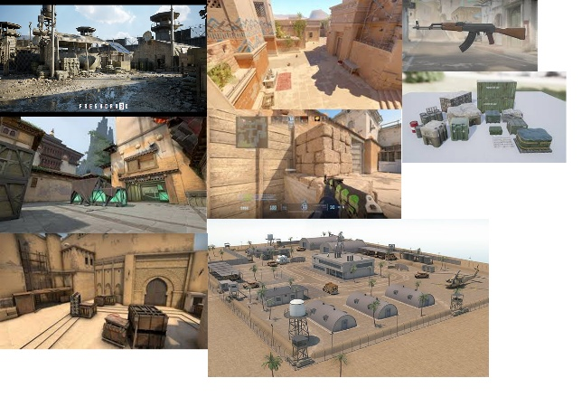
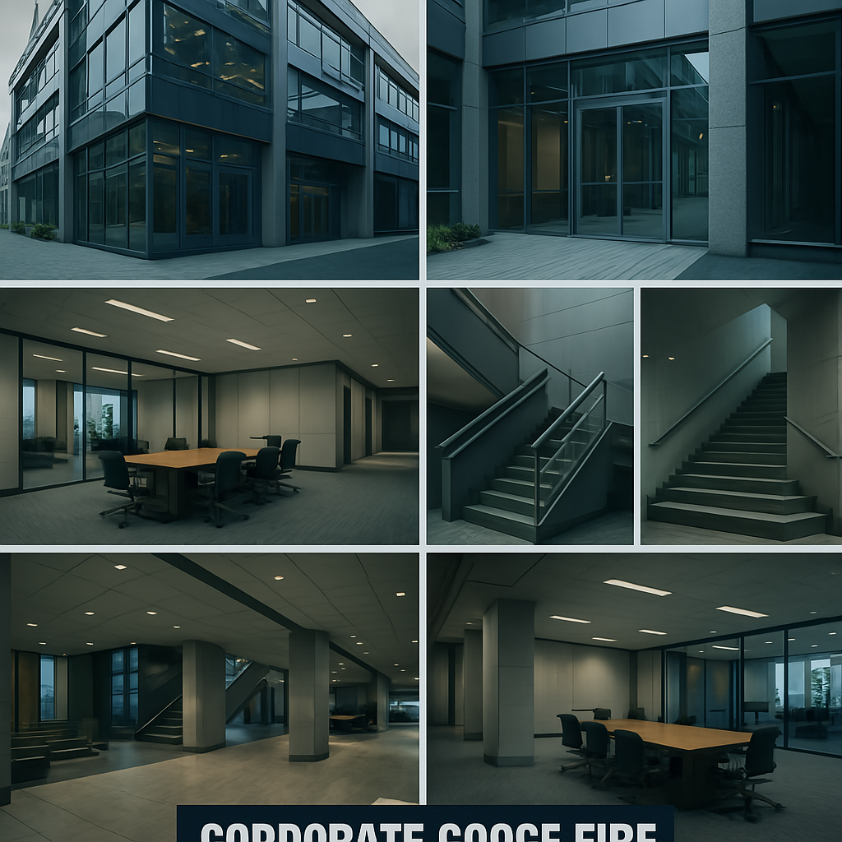
Moodboard

Slide 6
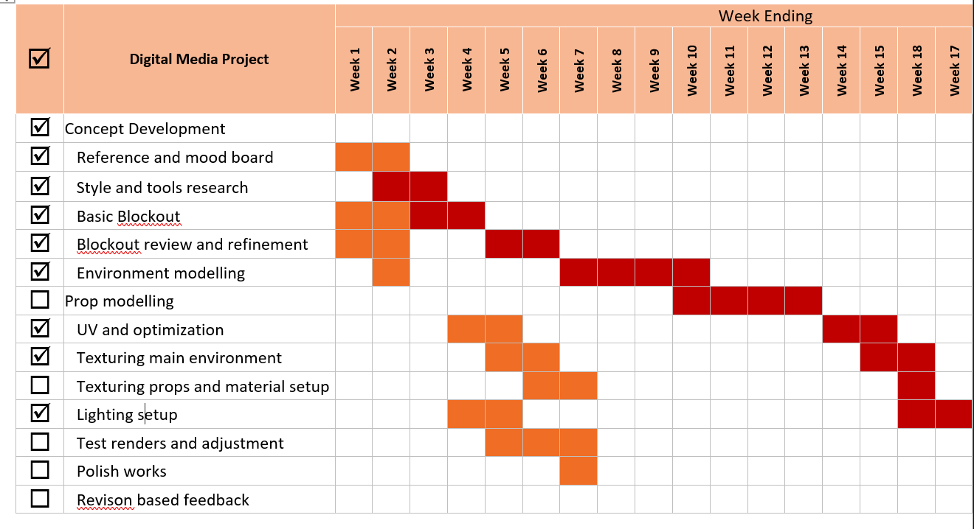
Gantt chart

Slide 7
Modelling Process
Entire of the modelling process was carried out in maya
Uv unwrapping was also done in maya

Slide 8
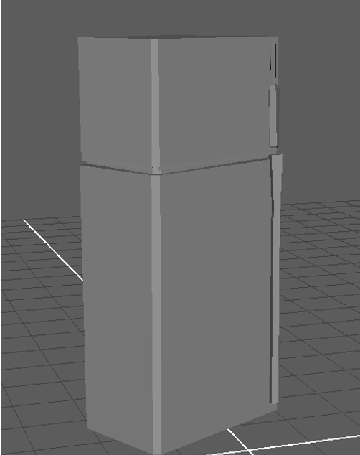
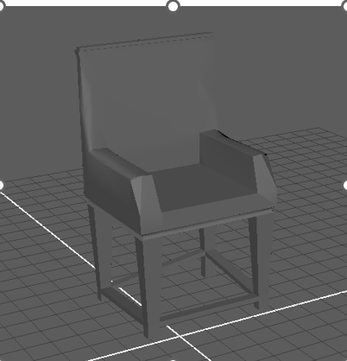
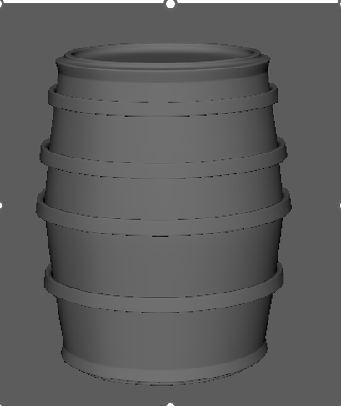
Props used in Environment

Slide 9
Texturing Process
Uv was done in Maya
PBR workflow was followed (Normal Map, Roughness Map etc)
Texturing was carried out in Substance Painter

Slide 10
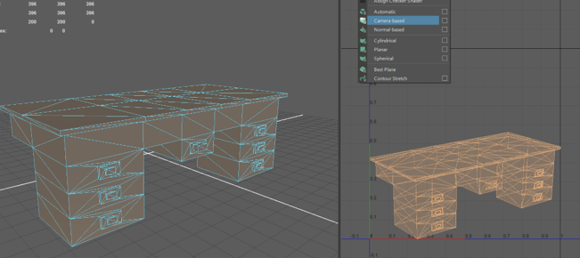
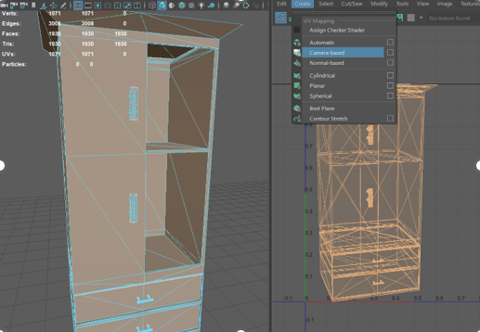
UV unwrapping of props

Slide 11
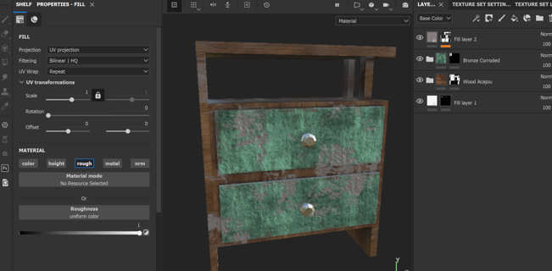
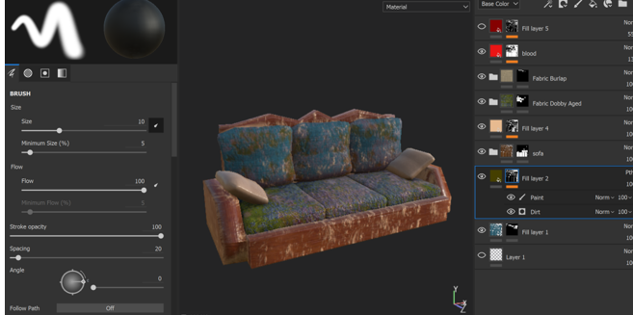
Texturing of Props

Slide 12
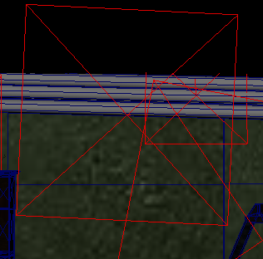
Lighting and Rendering
Lighting was done in maya
Only one kind of light was used i.e area light
Rendering was also done in Maya
Arnold Render Plugin was used

Slide 13
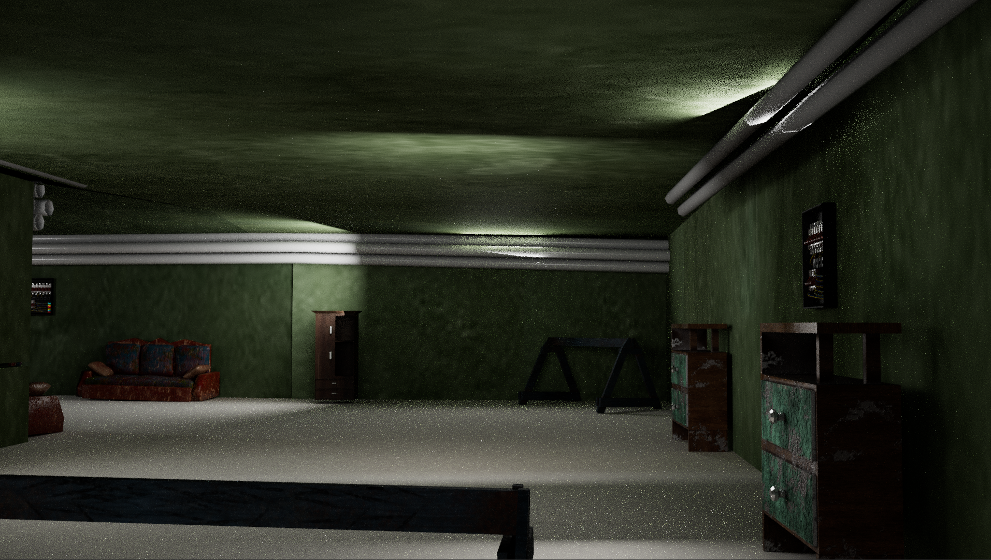
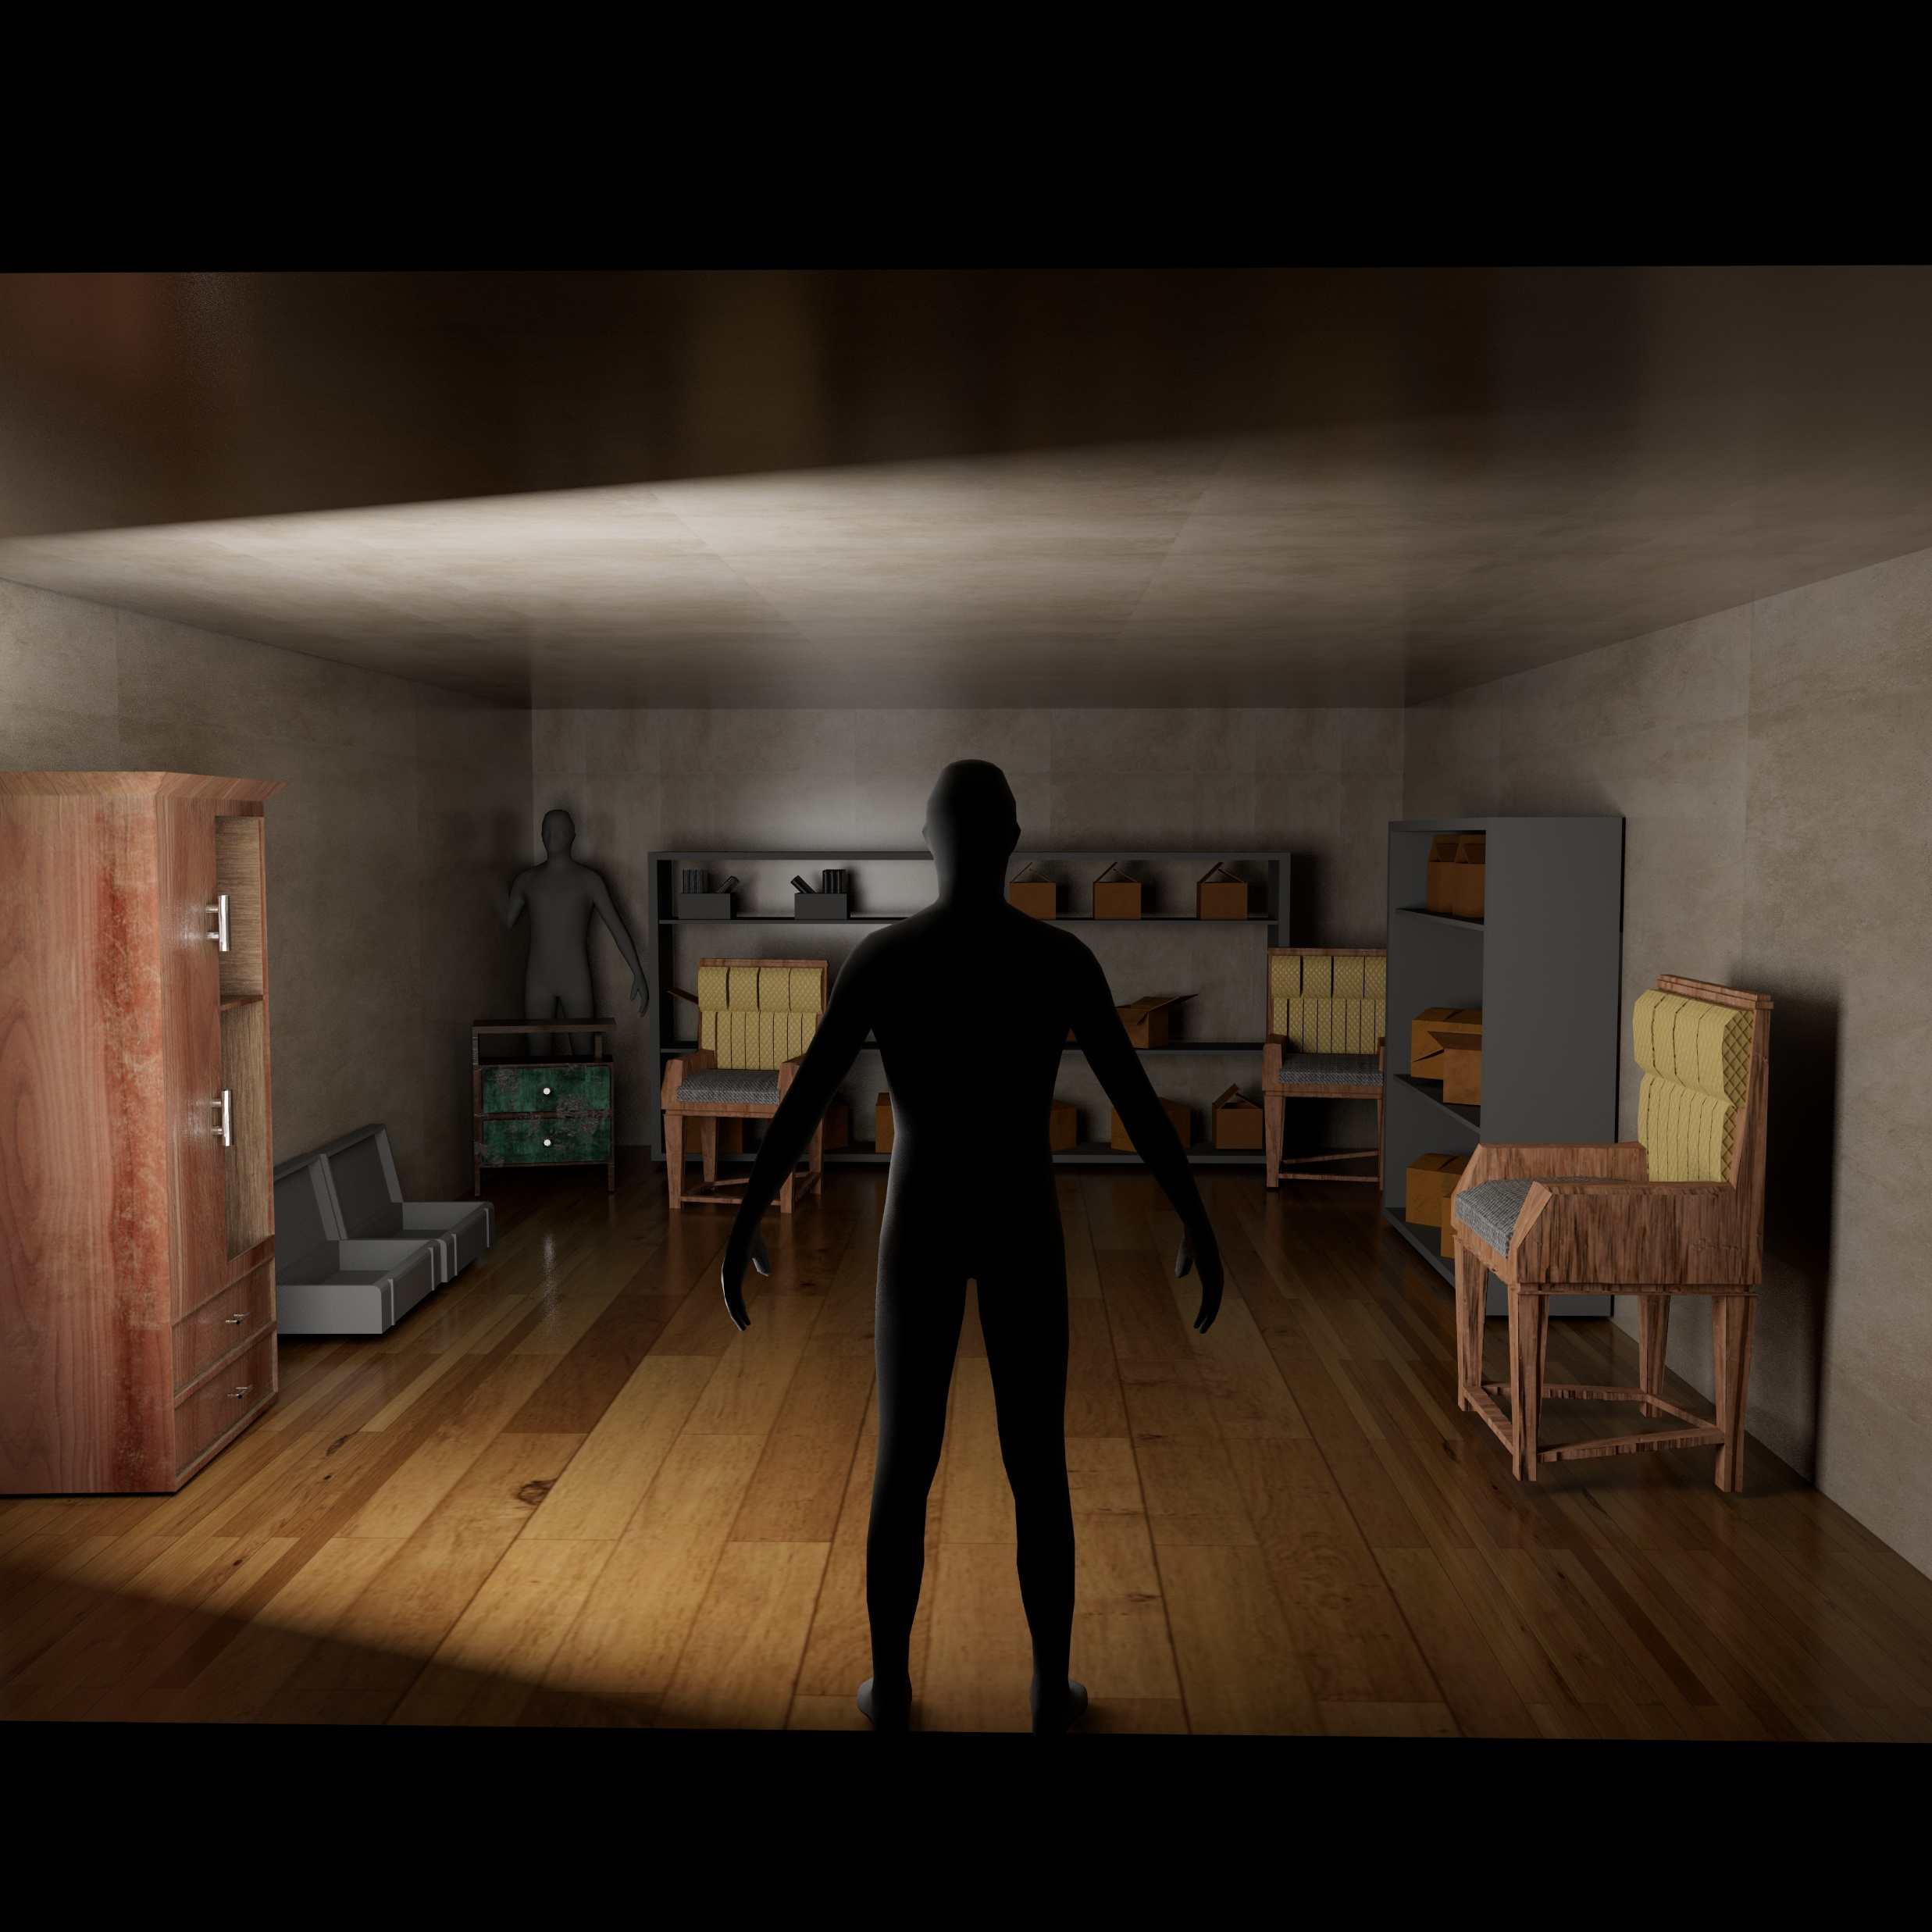
Final Output

Slide 14
Skill Gained
Learned full 3d pipeline
Better understanding of Texturing
Improved planning of project and Time Management

Slide 15
Conclusion
I handled all of the Project by Myself
Got better at problem solving
Learned a lot about every step

